Slide 1

146, 148, 151, 153, 153, 154, 155, 156, 156, 156, 157, 157, 159, 162, 162, 162, 163, 164, 164, 165, 165, 168, 168, 173, 174, 177, 181.
Find the Mean ______________
Mode ______________
Median _____________
Range ______________
2. A Bar chart has __________between the columns while a Histogram ___________. A bar chart displays ________________ data while a histogram displays ____________ data.
3. Sort the data above into classes.
Classes | Tally | Frequency
145 – 150
150 – 155
155 – 160
161 – 165
165 – 170
170 – 175
175 – 180
180 – 185
0 1 2 3 4 5 6
140 145 150 155 160 165 170 175 180 185
Notes:
Pages 1 and 2 To be completed during the accompanying presentation

Slide 2
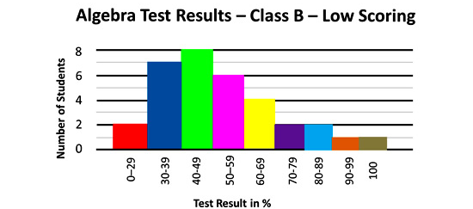
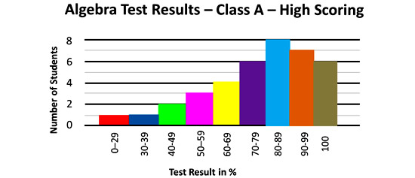
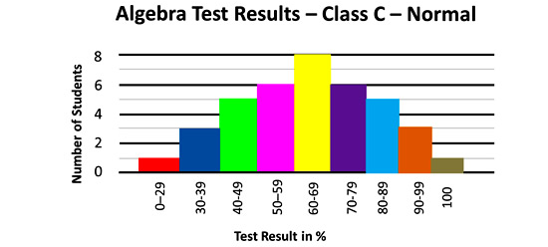
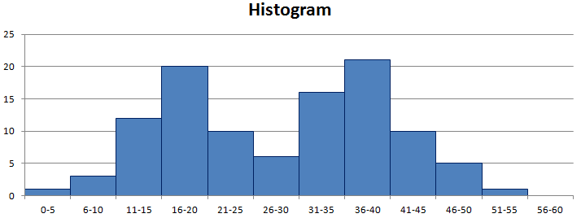
Graph 1 is an example of __________ skew. The mean is to the ________ of the median and the _________.
Graph 2 i_s an example of ___________ skew. The mean is to the ________ of the median and the __________.
Graph 3 is an example of ____________ skew. The mean is the __________ as the median and the ___________.
Graph 4 is an example of ___________ data. You can see on the graph it has 2 _________.

Slide 3
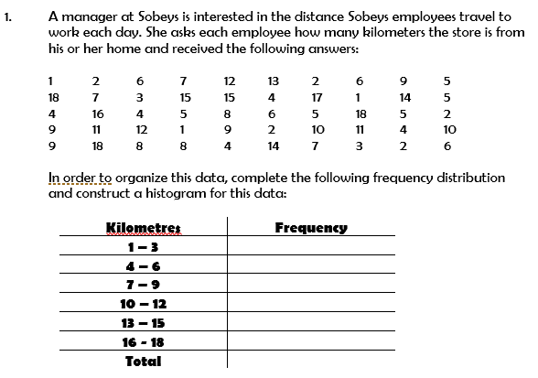

Notes:
This is the “Let’s Try together” activity from the presentation

Slide 4

Create a histogram for the following sets of data.
Hours (h) spent watching TV last week | Frequency
0 up to 5 | 3
5 up to 10 | 6
10 up to 15 | 10
15 up to 20 | 25
20 up to 25 | 10
25 up to 30 | 4
30 up to 35 | 1
The data below is information about the number of hours worked by some factory workers.
7, 9, 12, 13, 17, 19, 23, 24, 29, 29, 33, 35, 37, 38, 40, 42, 46
Complete the frequency table.
Use the table to draw a histogram.
Number of hours (n) worked | Frequency
0 < n ≤ 10
10 < n ≤ 20
20 < n ≤ 30
30 < n ≤ 40
40 < n ≤ 50
Notes:
This is the independent practice . More is available from pages 124 and 125 of Dr Dwyer yr 9 text book

